Slide 1

Interface PIC with LED,SWITCH,BUZZER and UART
DAY 19
EMBEDDED SYSTEM DESIGN & IoT-Master Class

Slide 2
What You will learn Today?
Interface LED ,Switch,Buzzer,Relay
UART

Slide 3
Mindset Lesson for the Day
The way you respond to any situation will change the Outcome

Slide 4
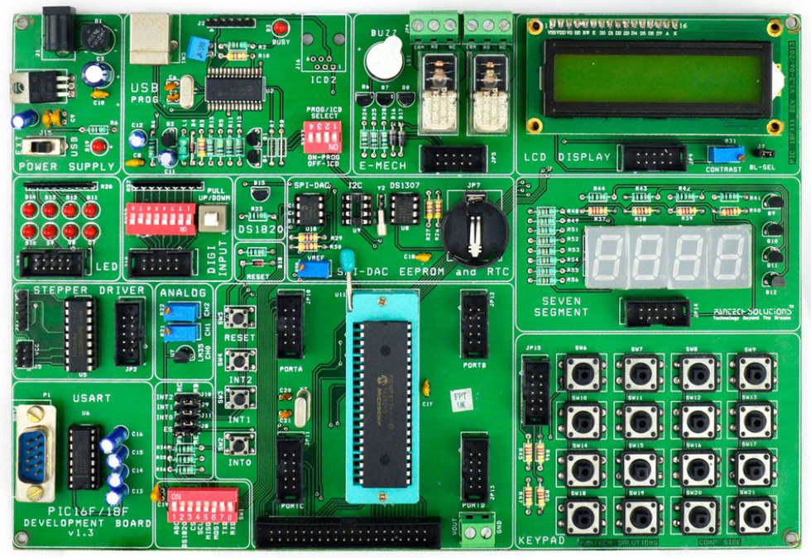
Embedded System Design using PIC
40pin-SIF Socket
8 Nos. Point LEDs (Logic Output)
8 Nos. Digital Input (DIP Switch)
4x4 Matrix Keypad
2X16 Character LCD (Background Light)
4 Nos. 7-Segment Display
2 Nos. Analog Input (Potentiometer)
Temperature Sensor (LM35)
Stepper Motor Interface
2 Nos. of SPST Relay
DS1307 RTC with Batter-Backup
USART(RS232)
USB 2.0 Enabled Programmer
Interrupts Study, Reset Button
SPI – EEPROM.25C040
I2C EEPROM 24C04
Digital Temperature Sensor(DS18S20)
4x10-Pin Expansion Connector
Piezo Electric Buzzer

Slide 5
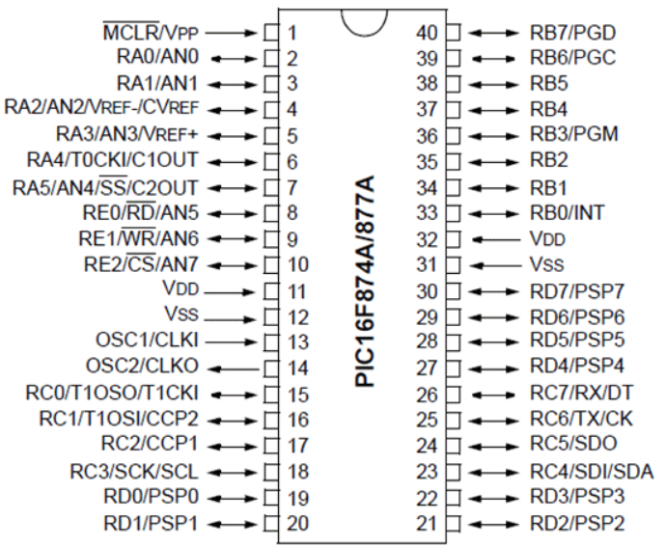
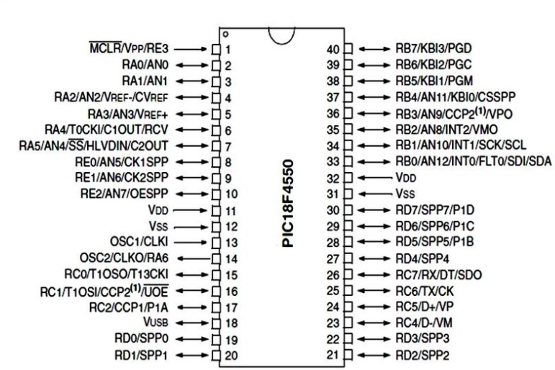
PIC PIN Diagram

Slide 6
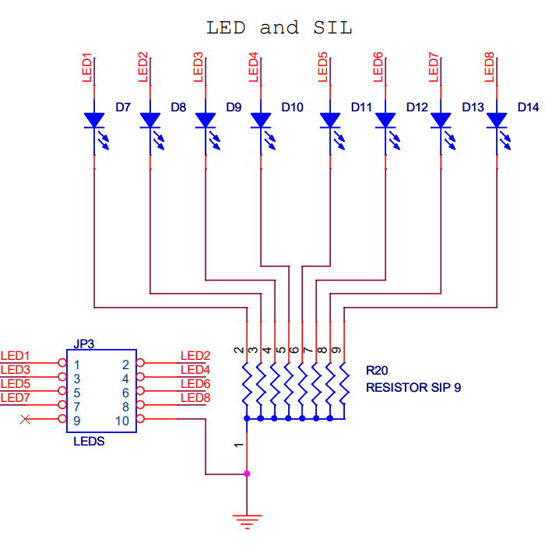
LED Interface

Slide 7
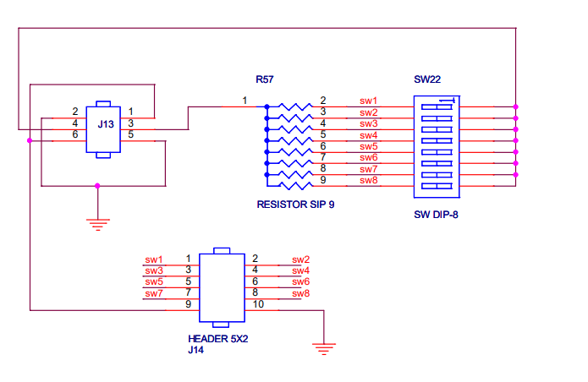
DIP SWITCH Interface

Slide 8
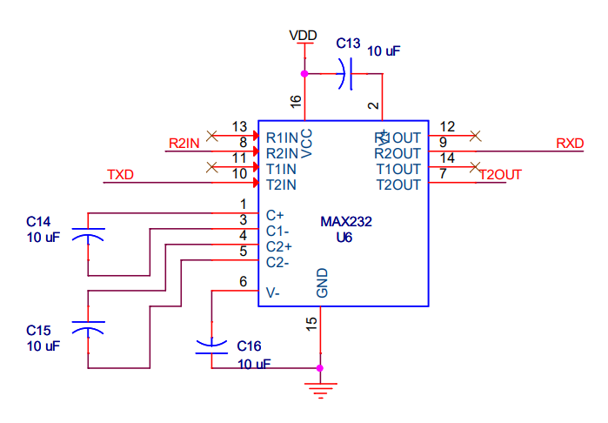
UART

Slide 9
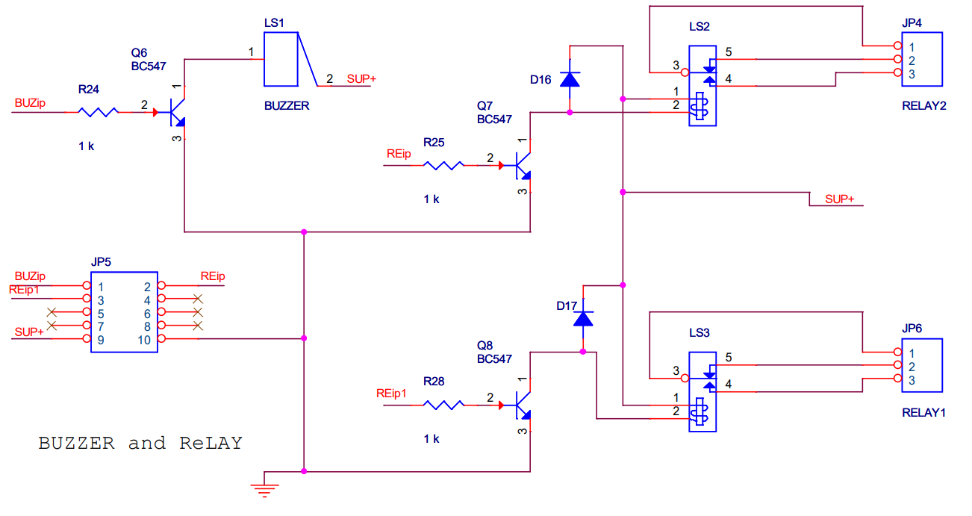
Buzzer and Relay

Slide 10
SWITCH AND LED
#include<pic.h> //Define PIC Registers
__CONFIG(0x3f72); //Select HS oscillator, Enable (PWRTE,BOREN),
void DelayMs(unsigned int);
void main()
{
DelayMs(10);
RBPU=0; //Enable weak internal Pull-Ups
TRISB=0xFF; //PORTB Configured as I/P
TRISC=0x00; //PORTC configured as O/P
PORTC=0x00;
DelayMs(10);
while(1)
{
PORTC=PORTB; //Move the input to output
DelayMs(500);
}
}
void DelayMs(unsigned int Ms)
{
int delay_cnst;
while(Ms>0)
{
Ms--;
for(delay_cnst = 0;delay_cnst <220;delay_cnst++);
}
}

Slide 11
UART Registers used for Serial Communication
TXSTA (Transmit Status And Control Register)
RCSTA (Receive Status And Control Register)
SPBRG (USART Baud Rate Generator)
TXREG (USART Transmit Register)
RCREG (USART Receiver Register)

Slide 12
USART MODES
The USART can be configured in the following modes:
Asynchronous (full-duplex)
Synchronous – Master (half-duplex)
Synchronous – Slave (half-duplex)

Slide 13
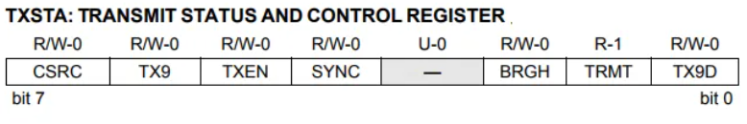
TXSTA (Transmit Status And Control Register)
CSRC: Clock Source Select bit (Asynchronous mode: Don’t care).
TX9: 9-bit Transmit Enable bit
1 = Selects 9-bit transmission
0 = Selects 8-bit transmission
TXEN: Transmit Enable bit
1 = Transmit enabled
0 = Transmit disabled
SYNC: USART Mode Select bit
1 = Synchronous mode
0 = Asynchronous mode
BRGH: High Baud Rate Select bit
        1 = High speed
        0 = Low speed
TRMT: Transmit Shift Register Status bit
1 = TSR empty
0 = TSR full
TX9D: 9th bit of Transmit Data, can be a Parity bit

Slide 14
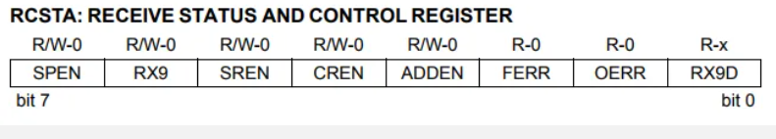
RCSTA (Receive Status And Control Register)
SPEN: Serial Port Enable bit
1 = Serial port enabled (configures RC7/RX/DT and RC6/TX/CK pins as serial port pins)
0 = Serial port disabled
RX9: 9-bit Receive Enable bit
1 = Selects 9-bit reception
0 = Selects 8-bit reception
SREN: Single Receive Enable bit (Asynchronous mode: Don’t care)
CREN: Continuous Receive Enable bit
Asynchronous mode:
1 = Enables continuous receive
0 = Disables continuous receive
ADDEN: Address Detect Enable bit
Asynchronous mode 9-bit (RX9 = 1):
1 = Enables address detection, enables interrupt and load of the receive buffer when RSR is set
0 = Disables address detection, all bytes are received and the ninth bit can be used as a parity bit
FERR: Framing Error bit
1 = Framing error (can be updated by reading RCREG register and receive next valid byte)
0 = No framing error
OERR: Overrun Error bit
1 = Overrun error (can be cleared by clearing bit CREN)
0 = No overrun error
RX9D: 9th bit of Received Data (can be parity bit but must be calculated by user firmware)

Slide 15
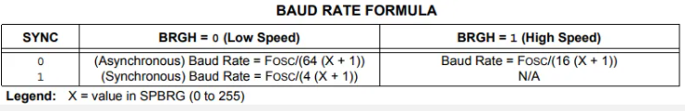
SPBRG (USART Baud Rate Generator)

Slide 16
Transmit & Receiver Register
TXREG (USART Transmit Register)
This is like a transmit buffer. But it is only an 8-bit register. So we have to place the character whatever we want to transmit via USART.
RCREG (USART Receiver Register)
This is like a receiver buffer. But it is only an 8-bit register. So we can take the character whatever we microcontroller received via USART.

Slide 17
Initializing USART
Configure the TXSTA Register for Transmit
Configure the RCSTA Register for Receiver
Feed the value for baud rate that you have calculated using the above formula to SPBRG Register

Slide 18
UART
#include<pic.h>
__CONFIG(0x3f72);
#define FOSC 10000 //10Mhz==>10000Khz
#define BAUD_RATE 9.6 //9600 Baudrate
#define BAUD_VAL (char)(FOSC/ (16 * BAUD_RATE )) - 1; //Calculation For 9600 Baudrate @10Mhz
void main()
{
unsigned char ReceiveChar;
TRISC=0xc0; //RC7,RC6 set to usart mode(INPUT)
TXSTA=0x24; //Transmit Enable
SPBRG=BAUD_VAL; //9600 baud at 10Mhz
RCSTA=0x90; //Usart Enable, Continus receive enable
TXREG='0';
while(1)
{
if (RCIF==1) //char received? Send 'A' back to Terminal
{
ReceiveChar=RCREG;
if(TXIF==1)
TXREG=ReceiveChar;
}
}
}

Slide 19
Thank You

